Slide 1


Human-Computer Interaction
&
Artificial Intelligence
Fabio Paternò
Human Interfaces in Information Systems Laboratory
CNR-ISTI, Pisa, Italy
fabio.paterno@isti.cnr.it
Notes:
Pippo pappo
CHI 2011 Course Notes 1 Siegel

Slide 2

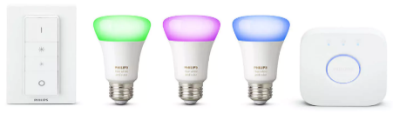




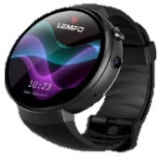
People Role in Daily Automations Creation
Model
Validation
Recommender
Users
Automations
EUD Tool
Model
Development
Run-time Support
Data Selection
IoT World
Requirements

Slide 3



Trigger-Action Programming
Useful connection point between the wide variety of technologies and implementation languages considered and people without programming experience
Personalization rules: when something happens (trigger) something must be done (action)
They do not require particular algorithmic skills or knowledge of complex programming structures
Dealing with temporal aspects associated with triggers and actions that may not execute as the user expects
Configuring smart environments with multiple active automations with unexpected effects
Security and/or privacy issues from the resulting automations

Slide 4


Experiences in AAL Projects and Trials
Remote Monitoring of End-User Created Automations in Field Trials M.Manca, F. Paternò, C.Santoro, Journal of Ambient Intelligence and Humanized Computing, 2021
Safety. WHEN the user falls down AND then it does not move for one minute DO send a text message to the caregiver
Comfort. WHEN move from bedroom AND IF time is between 11 p.m. and 6 a.m. DO turn on lights to go to the bathroom
Wellbeing. IF the training time is less than 30 minutes AND WHEN the time is 6 p.m. DO send a reminder
Health. WHEN NOT(taken medicine) between 08:00 and 09:00 DO send one alarm by text to caregiver
Energy saving. IF user is in bed AND time is between 11:00 p.m. and 06:00, DO turn off all lights in the bedroom
Socialization. If tomorrow’s forecast is good DO remind the user to call a friend to plan for a walk together tomorrow

Slide 5
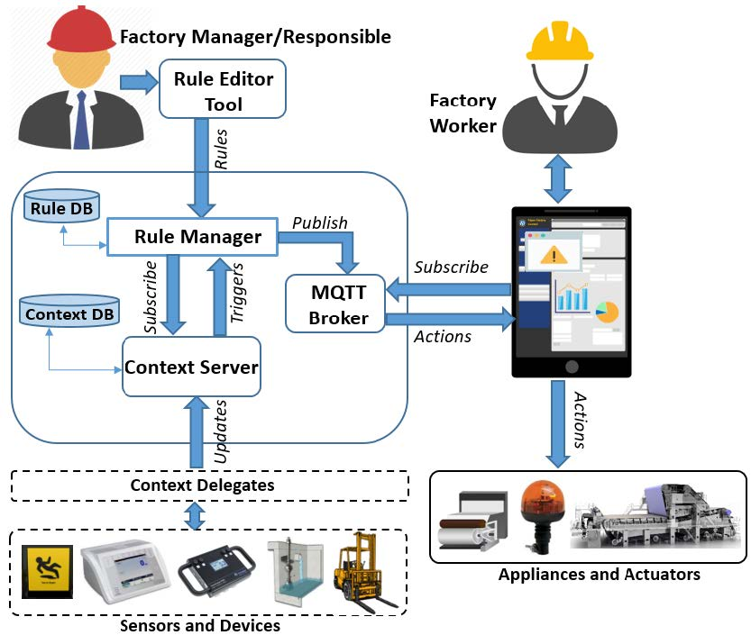
Personalization in a Paper Factory
M Manca, F Paternò, C Santoro, End-user development in industrial contexts: the paper mill case study, Behaviour & Information Technology, 2022,
Goals:
Efficiency
Safety of workers
Quality of production
Predictive Maintenaince

Slide 6
End-user automation debugging
M. Manca, F. Paternò, C. Santoro, L. Corc, Supporting end-user debugging of trigger-action rules for IoT applications, International Journal of Human-Computer Studies, 2019, Vol.123, 56-69

Slide 7
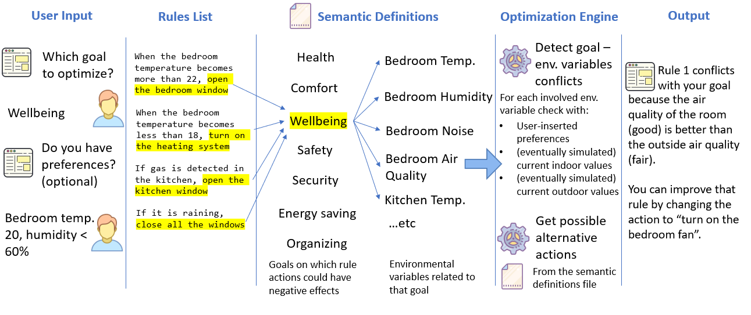
Goal-based Explanations with ExplainTAP
Project on End-User Development of Automations for Explainable Green Smart Homes
https://giove.isti.cnr.it/eud4gsh/index.html

Slide 8
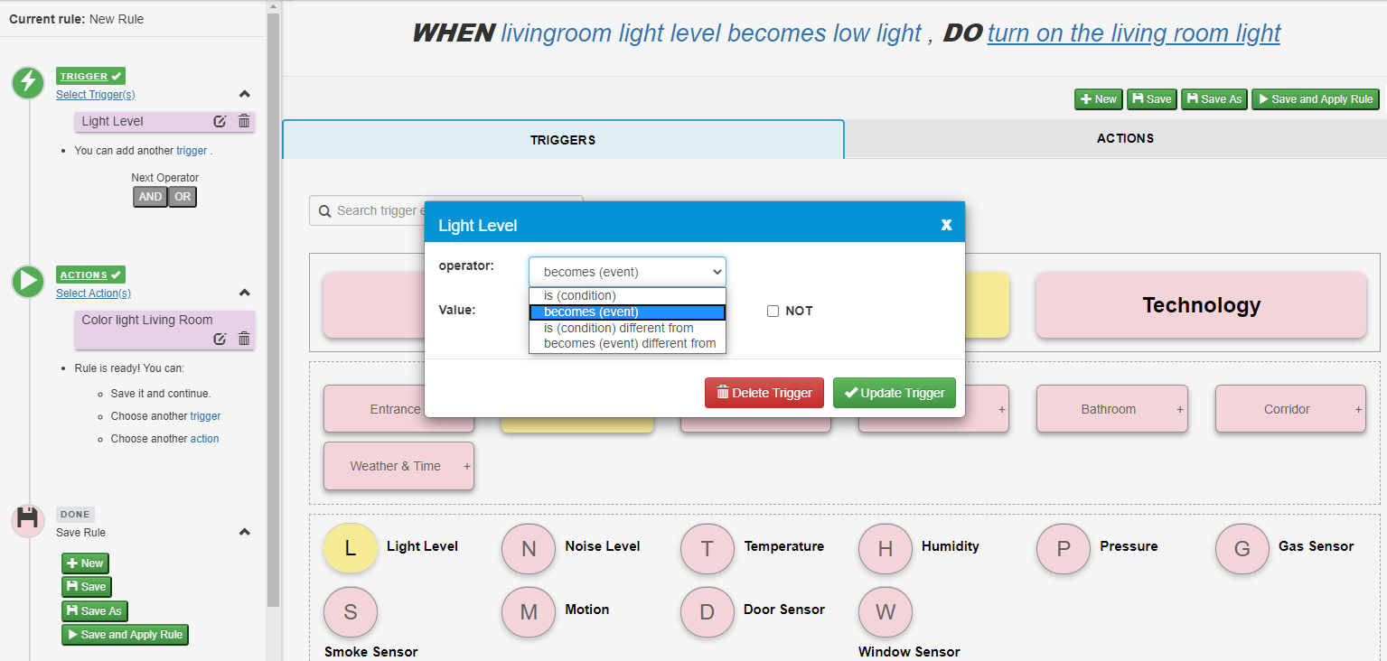
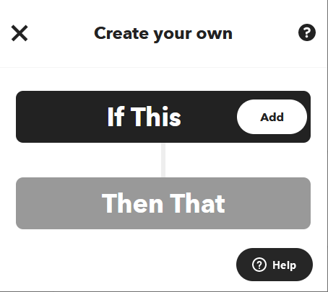
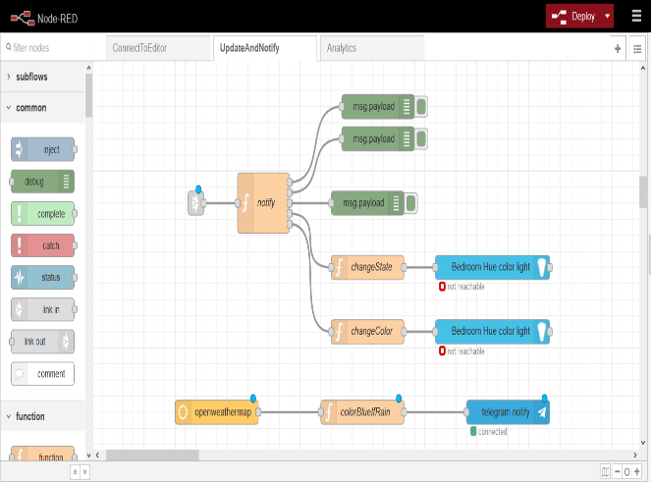
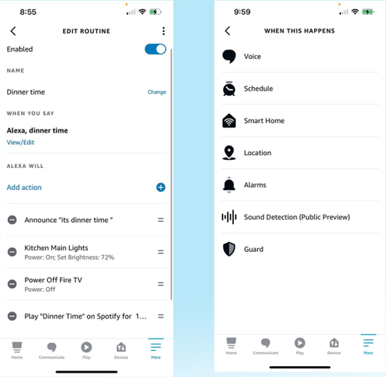
State of the Art: Visual Approaches
Wizard - TAREME
Alexa
Block-based - BlockComposer
Data Flow - NodeRed

Slide 9
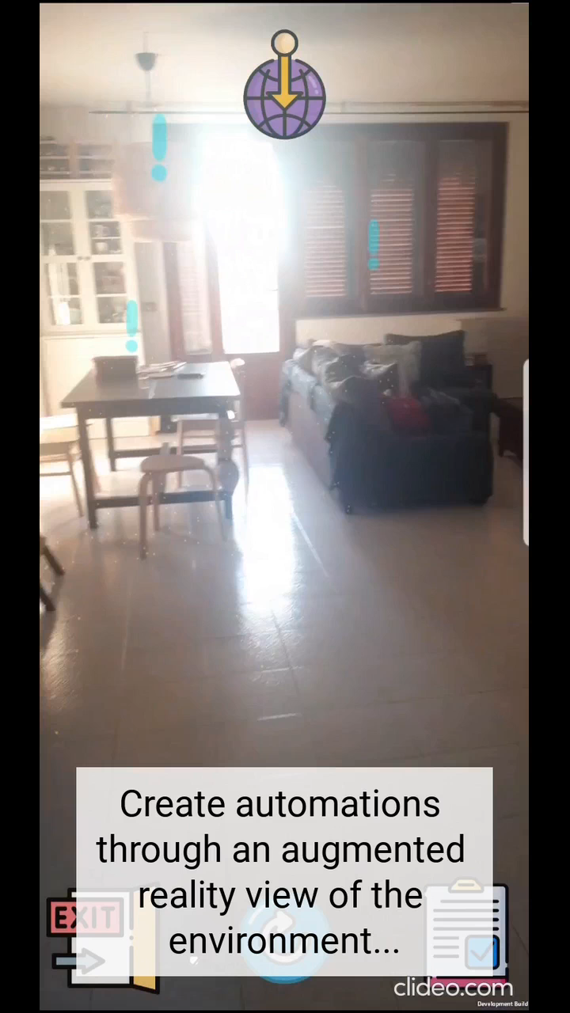
Mobile augmented reality for home automations EUD with recommendations
A. Mattioli and F. Paternò. 2023. A Mobile Augmented Reality App for Creating, Controlling, Recommending Automations in Smart Homes. In Proceedings of the ACM on Human-Computer Interaction, Vol. 7, MHCI, Article 195 (September 2023)
Avoid using special devices that many do not have
Possibility of direct interaction with the object of interest
Possibility of monitoring nearby automations while moving, also at different levels of granularity (object, room)
Ability to select a real object directly and know the automations that involve it
Ability to create new automations
Ability to modify existing automations
Notes:
ARFoundation is a unity library that provides an interface over the platform's native AR SDK such as Google ARCore, Apple ARKit, and OpenXR, facilitating the development for multiple platforms.
There is no need to go near an object and wait for recognition before interacting with it because the coordinates of the various objects are stored at the first use of the application. Then, on subsequent launches of the application, an AR anchor is associated with those coordinates and is used to place a visualization near the related objects.
Recommendations … indicating some possible continuations of the automation.
--------
an AR anchor is associated with a location for each activatable object in the smart home. At the start of the application, the coordinates for the anchors are loaded and visualizations are placed near the related objects.

Slide 10
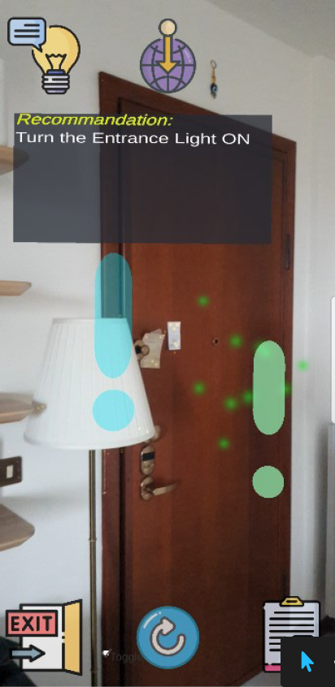
Intelligent Recommendation
They can exploit data sets, user behaviour, current interactions
Beginners -> guided / Advanced users -> new possibilities
Specific characteristics of the MAR setting:
the creation of rules does not necessarily occur in a sequential manner.
scarcity of space on the mobile screen,
Neural Collaborative Filtering & BERT-Based classifier
[0, 1]
Score
Concatenate
NCF + Context
Bert Classifier
Item vector
User vector
Context vect.
Bert vector
Event:weather-isRaining
Student-12
Action:sms-notification
Send the message: “close the windows!!”
Candidate rule element
User ID
Current input
Sentence describing the partial rule entered
Notes:
Furthermore, we also have to consider the peculiarities of providing recommendations in an AR setting:
the first is that the creation of rules does not necessarily occur in a sequential manner
Then we have to consider that mobile phones have limited screen space.
Hence, we have to maximize the utility of the presented suggestions also considering their diversity, in addition to their relevance to the user input.
The used dataset is available on github.

Slide 11
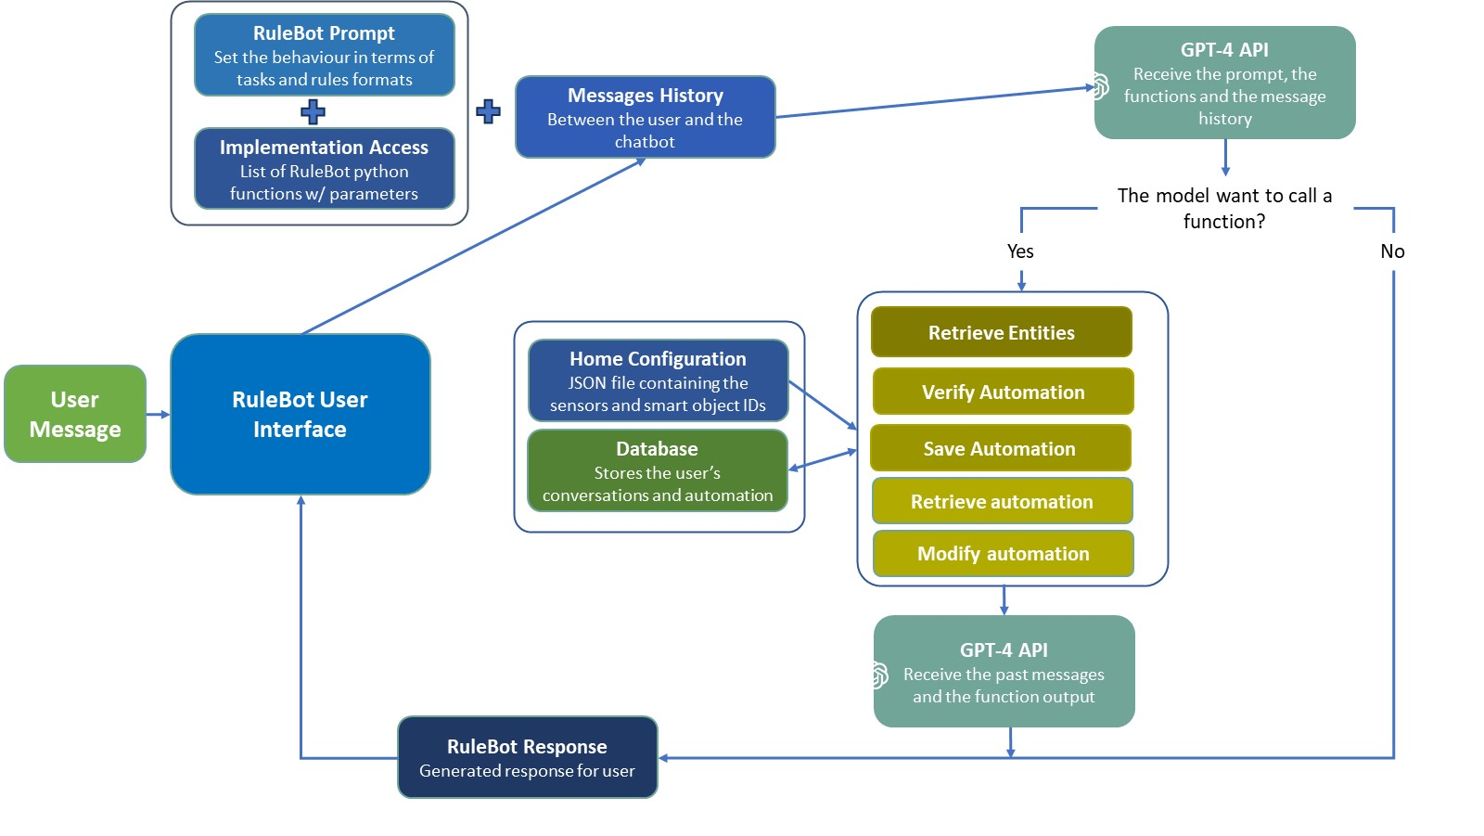
Creating automations with ChatGPT support

Slide 12
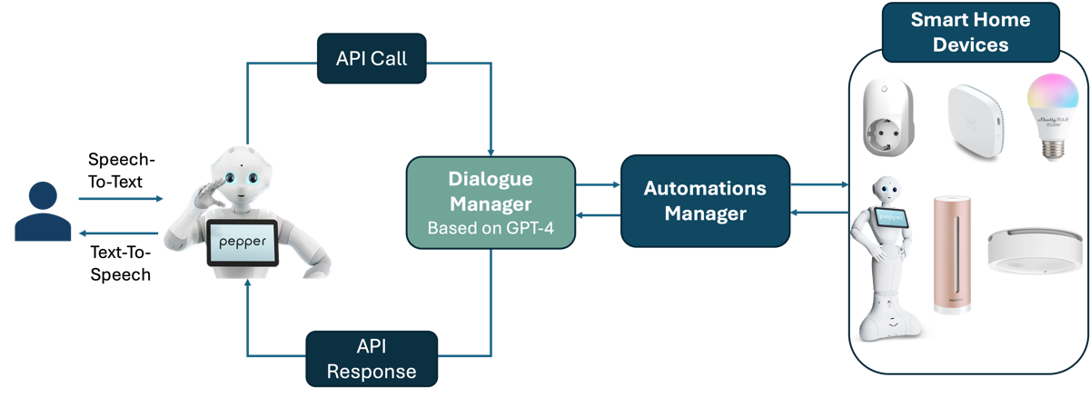
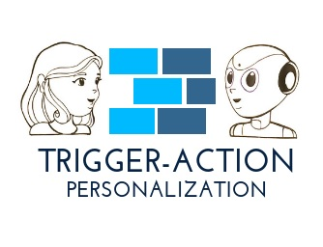
The Approach can be Extended to Robots !

Slide 13
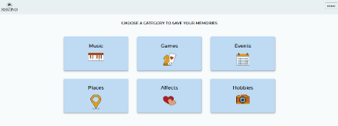

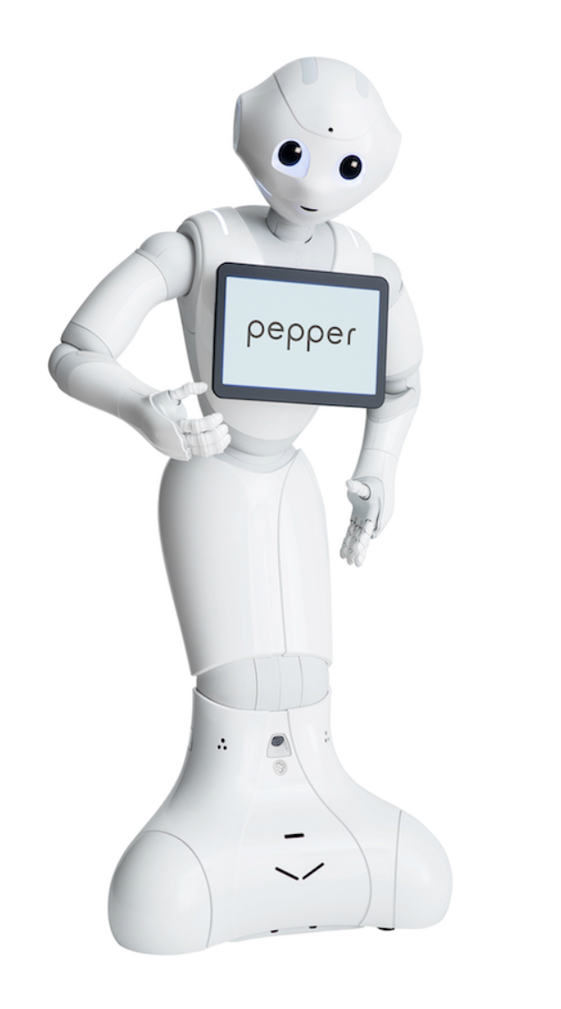


Personalised Train the Brain Exercises
The Impact of Serious Games with Humanoid Robots on Mild Cognitive Impairment Older Adults M Manca, F Paternò, C Santoro, E Zedda, C Braschi, R Franco, A Sale, International Journal of Human-Computer Studies, 2020
First step: collection of personal memories with Biography Web App
In collaboration with CNR Neuroscience Institute
SERIOUS GAMES BASED ON PERSONAL MEMORIES
FOR COGNITIVE AND SOCIAL STIMULATION
Memory
Attention
Executive
Functions
SocialSkills
Second phase: exercises in the gym
Web Biographical App to collect personal memories to personalize games
Six games automatically tailored to exercise cognitive resources such as memory and attention
Robot has two different personalities to drive engagement and user experience
Game Data
Personal Memories
Response time
Completion time
Correct/Wrong Answers
Session Duration & Data
memories
Favourite music and sports,
Childhood
Games
...
Personality
Extroverted and introverted personalities
Improves engagement, attention
Monitoring

Slide 14

IUI 2025
24-27 March 2025
Cagliari, Italy
30° Annual ACM Conference on Intelligent User Interfaces
Where
Human-Computer Interaction
Meets
Artificial Intelligence

